Slide 1


TITAN 2.0 Reviewer
Lt William Head and Sgt Michael Lowe
TITAN/IBM Team
Notes:
This PowerPoint shows the basics of how to Review a TITAN 2.0 crash report.

Slide 2
TITAN 2.0 Crash on the Web
Site is titan.safety.tn.gov
Available on any device with active internet service
Use an up-to-date browser: Chrome, Firefox, Edge, Safari, etc…
NOT available for offline use.
Username, Password, and profile are mirrored from TITAN Client
Any crashes/reports created in TITAN Client are not editable in TITAN 2.0
When you pull in a report to review and you do not reject or approve it in approximately 8 hrs, it will automatically get sent back to the review queue and discard any edits you may have done.
Your “pending” review text notifications can be discontinued in your TITAN 2.0 profile by checking the Opt Out feature. The notifications are set to notify you when approximately 30 minutes is left in the auto RTQ (Return To Queue) feature.
Notes:
Must have an active internet provider to access the site.
Site is titan.safety.tn.gov
The username and password are the same from the TITAN Client or TITAN Portal
Reports created in the TITAN Client are not editable in TITAN 2.0 and vice versa

Slide 3




Action Buttons
At the bottom of the pages there are four buttons that may appear:
Previous- takes you to the previous page.
Next- takes you to the next page.
Save- saves the information entered.
Validate- this button will show the validations only for the current page.
The Attachments section has the Validate All which checks the complete report for errors.
Reject- this button will send the report back to the investigator/submitter for revisions. The notes will collect your input to relay back to the investigator.
Validate All- this button is only visible on the last section of the report and will check all errors. Successful validation will give the Approve button.
Approve- this button approves the report to become official and be available to the public.
Notes:
The Validate button can be used on each individual page. It gives the validation errors as a guide. You can fix the errors as you go or wait until the end of the report with the Validate All. The Approve and Reject buttons will only appear on the Attachments/Narrative section.

Slide 4
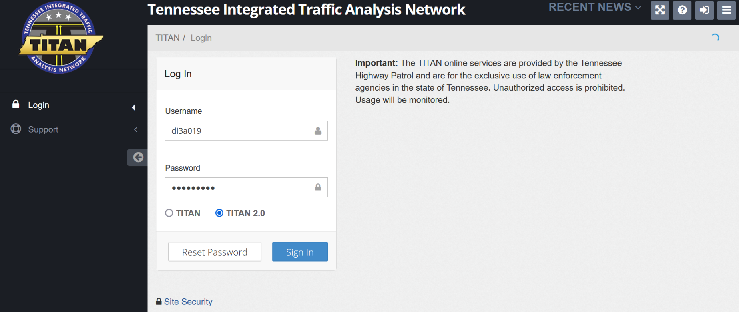

Login
TITAN 2.0 is available at titan.safety.tn.gov
Click the TITAN 2.0 then Sign In
Don’t forget that you are not a robot!
Notes:
The sign-in page is the same but takes you to an alternate site for TITAN 2.0

Slide 5
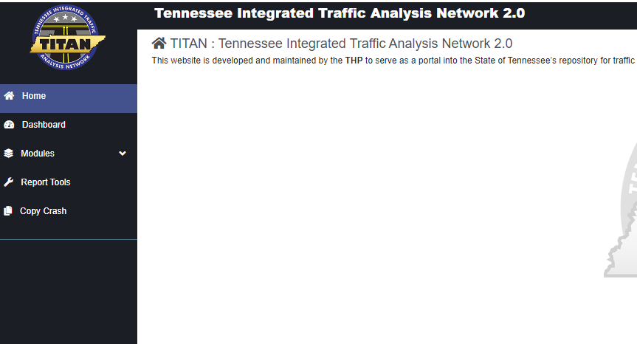
Dashboard
Using the left navigation, click on the Dashboard module to see your 2.0 reports. If the navigation is minimized, hover the rpm gauge to see more.
Notes:
Use the navigation bar to the left to get to the 2.0 reports dashboard.

Slide 6
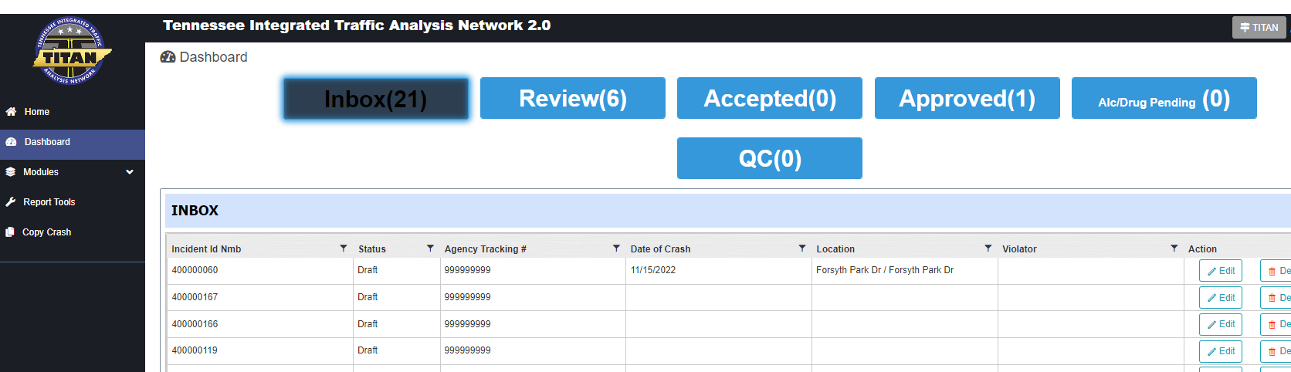
Review Tab
Click on the Review tab to see the reports that are available to review.
NOTE: The number displayed on the button is a count of ALL the reports listed in the Review tab, and includes every section/shift/group in which you have review rights.
Notes:
The Dashboard view is defaulted to Inbox. Click the Review tab to see the reports that are available to review. The number listed on the button is a count of review ready reports. This number will include all the reviewable reports from every

Slide 7
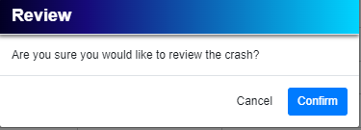
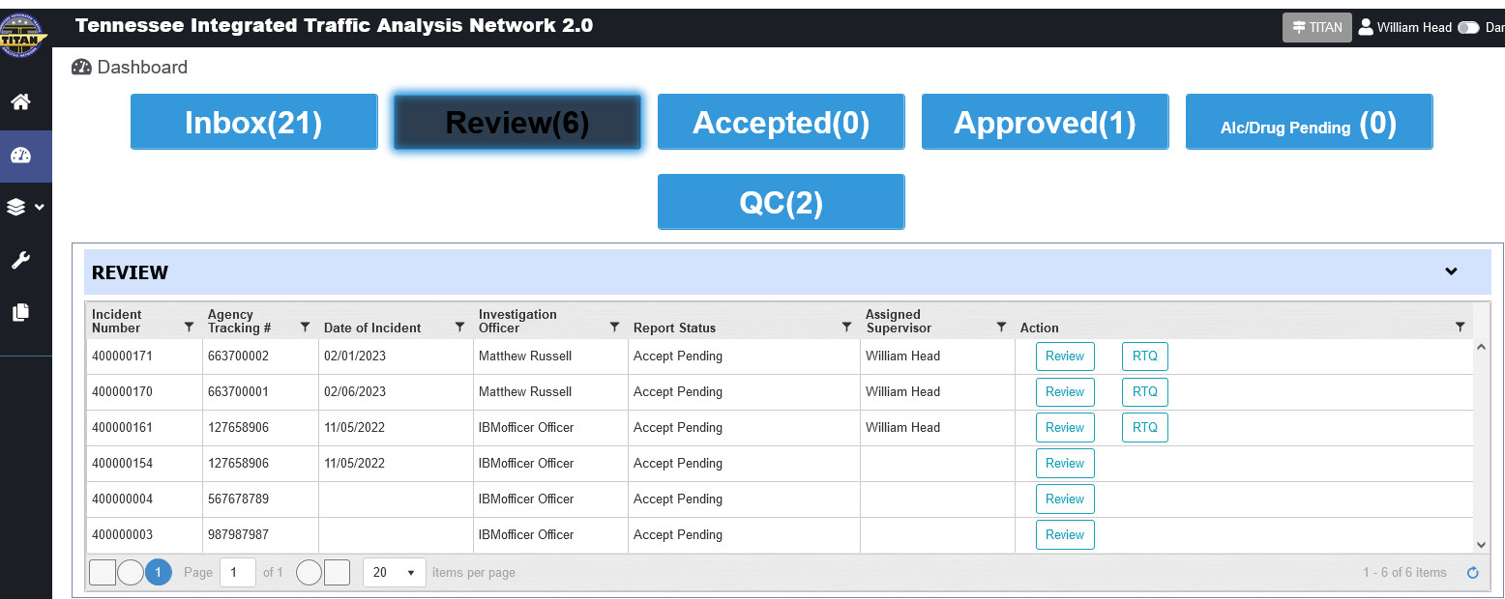
Review Report
In the Review Dashboard, click Review of the report you would like to review and approve or reject.
Select Confirm to assign yourself as the reviewer. The report will open for review.
If there are numerous reports, use the filter option at the top of each column to find specific reports.
NOTE: THE REPORT WILL AUTOMATICALLY GET RETURNED TO THE QUEUE IF YOU DO NOT APPROVE OR REJECT THE REPORT WITHIN 8 HOURS.
Notes:
Use the Dashboard/Review tab to pull the report into your profile for review. If you then decide not to review the report, click the RTQ button (Return To Queue) and the report will again be seen by any other reviewer with rights to that report. If there are numerous reports, the filter option at the top of the display columns can be utilized.

Slide 8
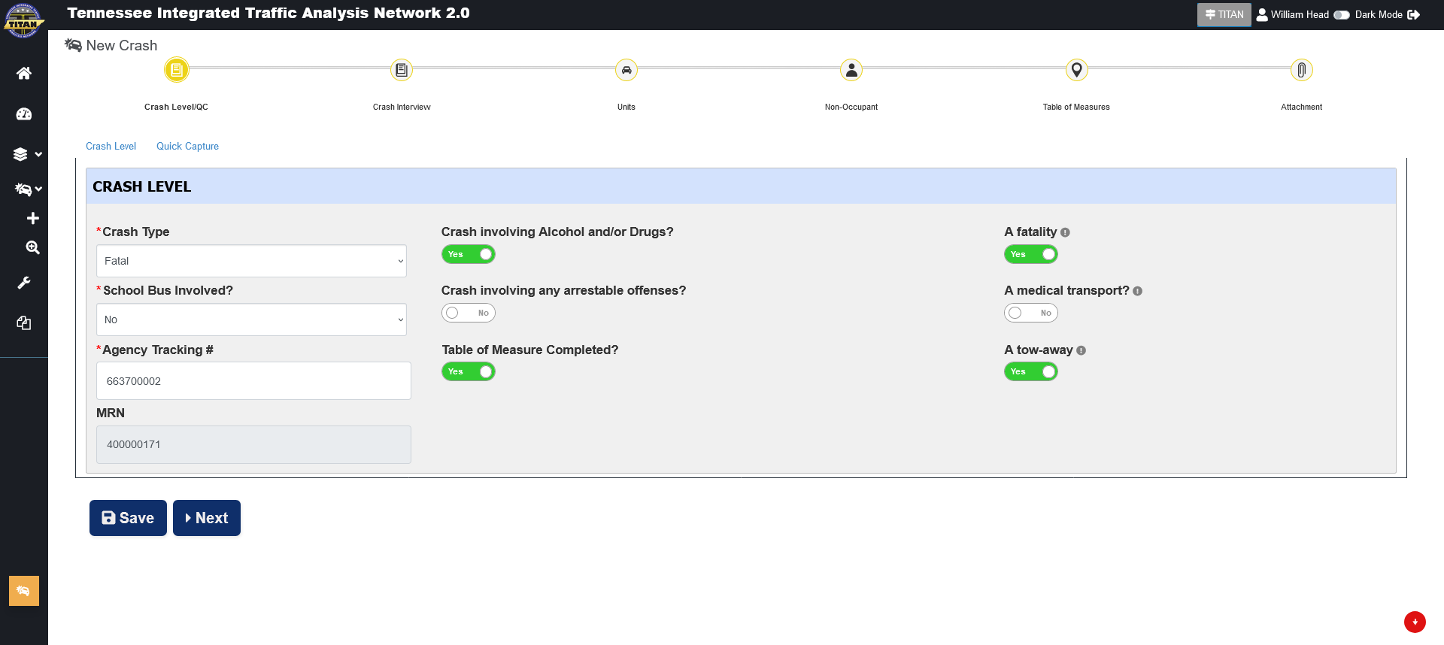


Review & Navigate
Once the report is opened, you can review and navigate through the report with the action buttons at the bottom or navigating directly to the sections at the top.
Note: The Table of Measures will only be available if you or the investigator have set the Table of Measure Completed? as Yes
Notes:
Review the entries and navigate by the action buttons or clicking on the section you want to view.
The Table of Measures section will be grayed out until the slide button is moved to YES

Slide 9
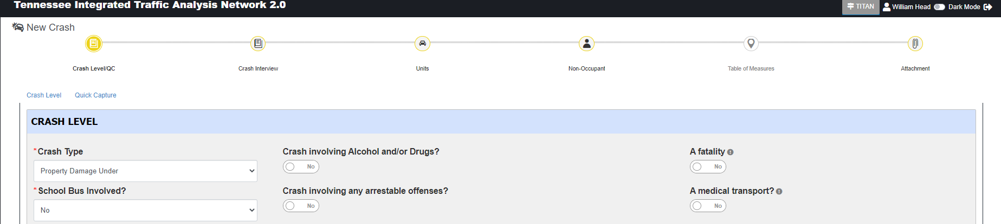
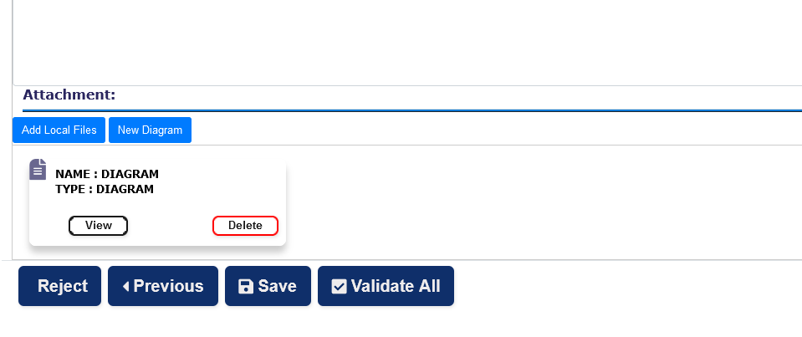
Validate All
Validate All (on the Attachment section) scans every entry for validation errors. If no validation errors are found through the complete report, the Approve and View Report buttons will become available.
NOTICE: If the Approve and View Report do not appear, you still have validation errors in the report. Review the red sections and correct any errors.
Notes:
Once the Validate All has been pressed, all the validations will apply to all the sections of the report. If there are no errors, the Approve and View Report buttons will show as options (see next slide).
If you click away from a validated report or change anything, the Approve and View Report will disappear. Simply Validate All again.

Slide 10
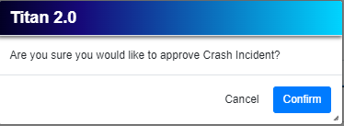
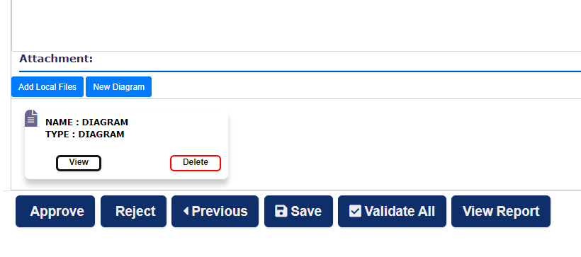
Approve Report
If no validation errors are found through the complete report, the Approve and View Report buttons will become available.
If they do not appear, you still have validation errors in the report. Review the red tabs and correct any needed information.
Notes:
The Approve and Confirm will send the report to the server for processing. It should be fully processed an approximately 5 minutes. Once processed, the reports YOU approve will also be listed in the Dashboard/Approved tab. You will have an option to “RTQ” the report back for you or another supervisor to edit/review/approve.

Slide 11
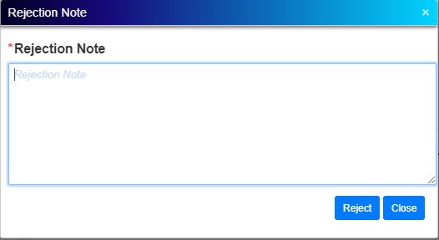
Reject a Report
Reject(on the Attachment section) sets the reports to go back to the investigator. You will get a Rejection Note popup to remark your reasons of rejection. All remarks will be visible to the investigator and any subsequent reviewer. All rejection remarks will be listed chronologically for each rejection.
Notes:
Reject(on the Attachment section) sets the reports to go back to the investigator. You will get a Rejection Note popup to remark your reasons of rejection. These remarks will be visible to the investigator and any subsequent reviewer. All rejection remarks will be listed chronologically for each rejection.

Slide 12
RTQ (Return To Queue)
The RTQ button in your Review tab will send back any reports you have assigned to yourself, and then decided not to review. The reports go back to the queue for the other reviewers to see and pull in to review. The RTQ will automatically occur if you do not approve or reject the report within 8 hrs.
Notes:
The RTQ will only show if you have previously pulled the report to review. You can immediately return it to the queue if you wish. Each report will automatically return to the review queue if not approved or rejected within approximately 8 hrs.

Slide 13
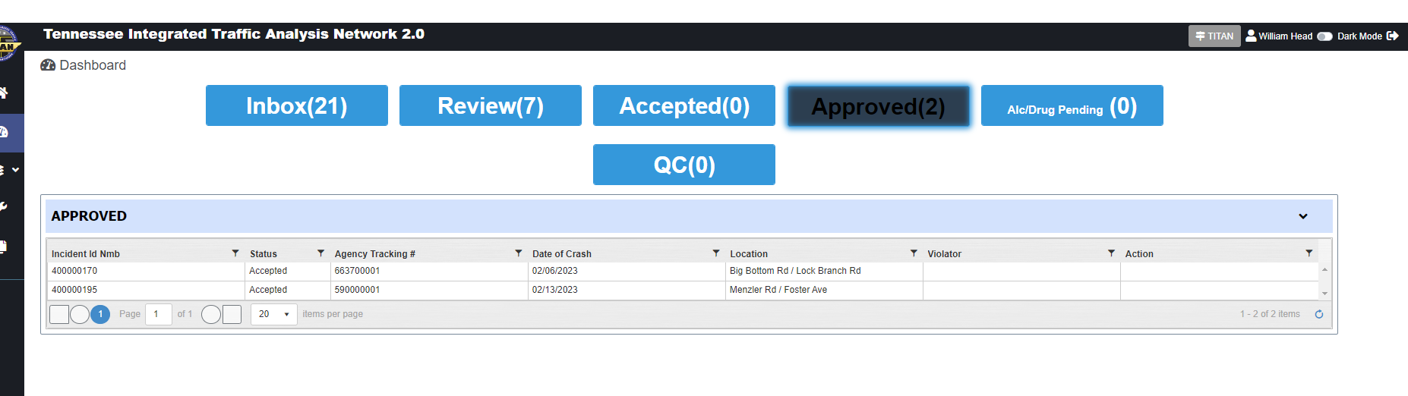
Approved Reports
Reports that YOU have previously approved are in the Approved tab.
Notes:
In the Approved tab of the Dashboard, you can see the reports that you have previously approved. The RTQ button will send it back to the Review tab for you to start the edit/review/approve process again.

Slide 14
Questions?
TITAN 2.0 Crash
Lt William Head william.head@tn.gov
Sgt Michael Lowe michael.lowe@tn.gov
TITAN Help Desk titan.safety@tn.gov

